Slide 1
Microfacies السحنات الدقيقة
المحاضرة الأولى
1- مقدمة
2- مفردات المنهج
3- المصادر
4- تقسيم الدرجات
5- مواعيد الاختبارات

Slide 2
References
*Manual of carbonate sedimentology a lexicographical approach
(Reijers & Hsu)
Microfacies analysis of limestone (Erik flugel)**
***Acolor illustrated guide to carbonate rocks constituents texture ,cements ,and porosities (AAPG)
****Carbonate facies in geologic history (Wilson)
*****A Color Guide to the Petrography of Carbonate Rocks:
Grains, textures, porosity, diagenesis

Slide 3
Key words
Microfacies , Carbonate rocks , Sedimentary Basin, Digenesis Process , porosity in thin section Classification of carbonate rocks , Standard Microfacies , Platform, Shelf , Epiric shelf ,Thin section

Slide 4
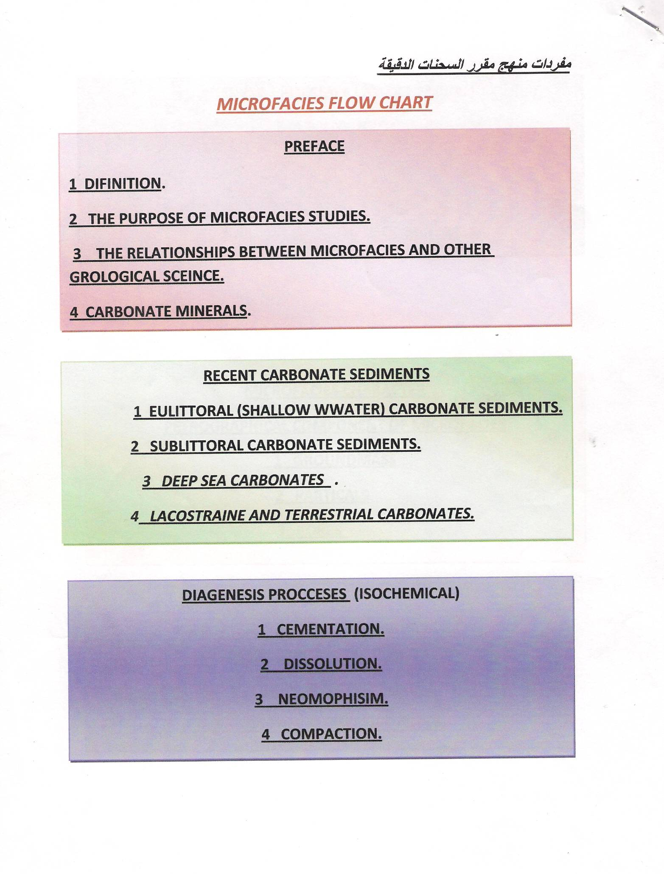

Slide 7
Preface المقدمة
Rock Typesأنواع الصخور

Slide 8
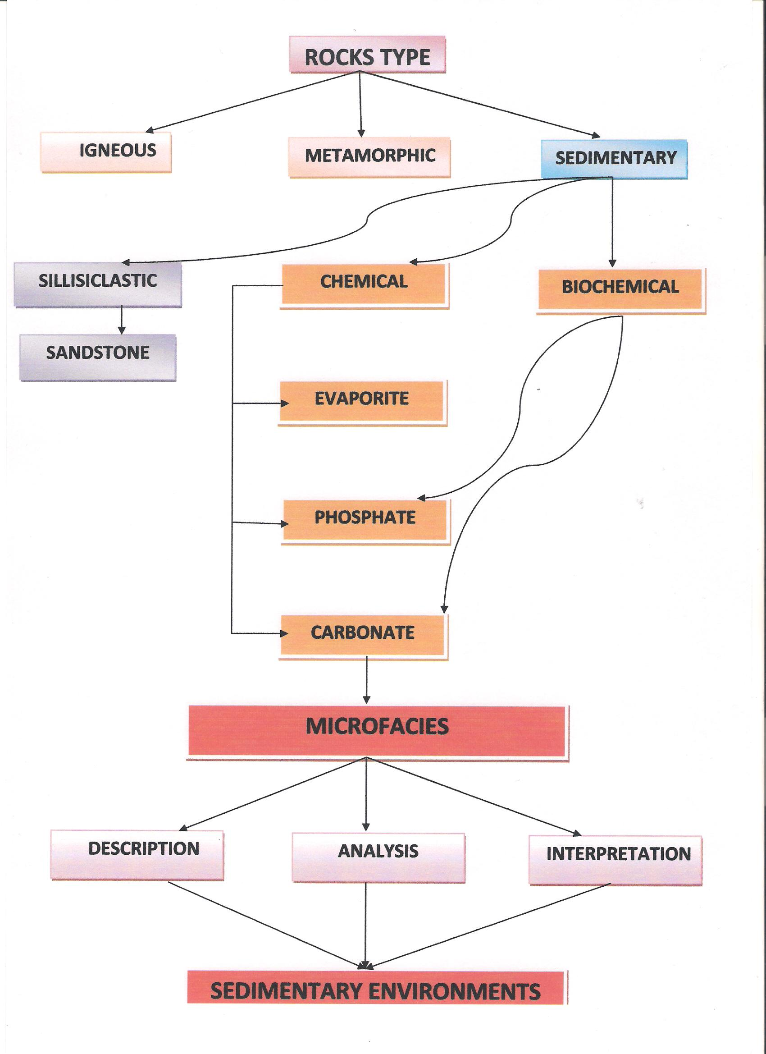

Slide 11
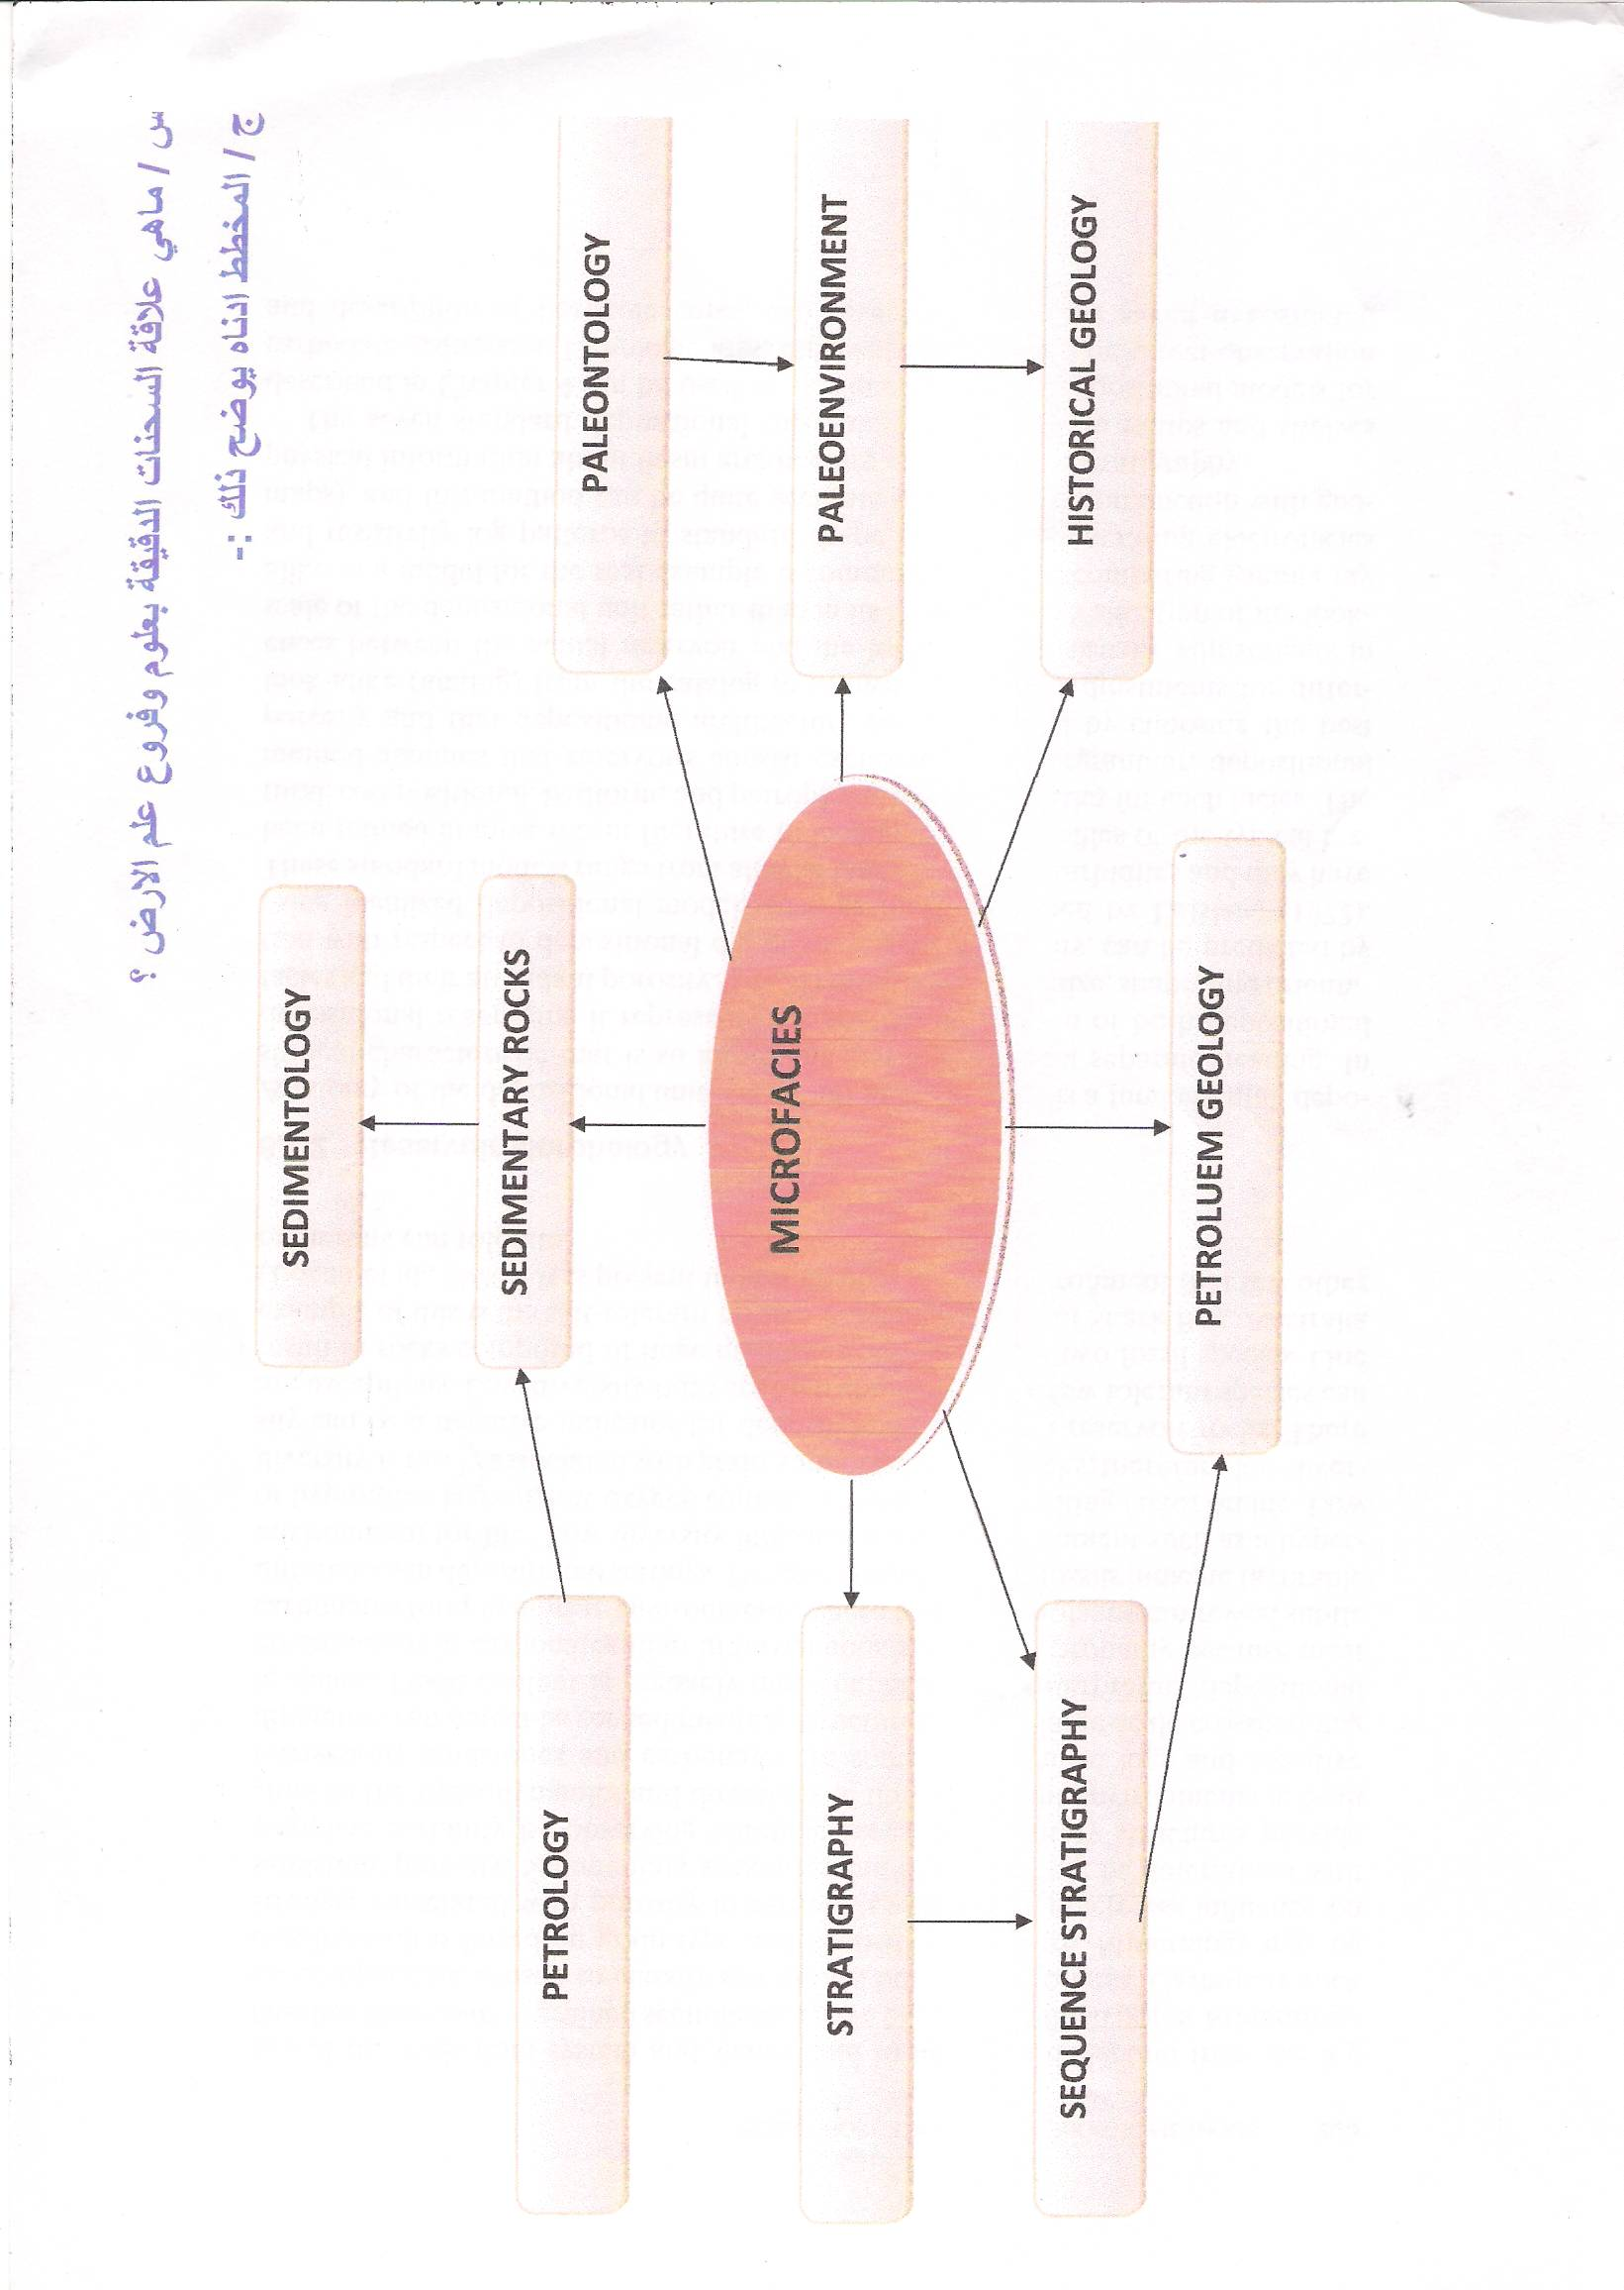

Slide 12
Sedimentology
Sedimentary rocks
paleoenvironment
Petroleum geology
Paleontology
Microfacies
Stratigraphy
Historical geology
Sequence stratigraphy
Reservoir geology
Petrology

Slide 13
Microfacies Project
Microfacies Project
Description
Analysis
Interpretation

Slide 14
Carbonate Minerals
Ca co3

Slide 15
There are three type of carbonate minerals
Calcite caco3
Aragonite caco3
Dolomite CaMg (co3)2

Slide 16
Carbonate Minerals
Aragonite
Calcite
Dolomite

Slide 17
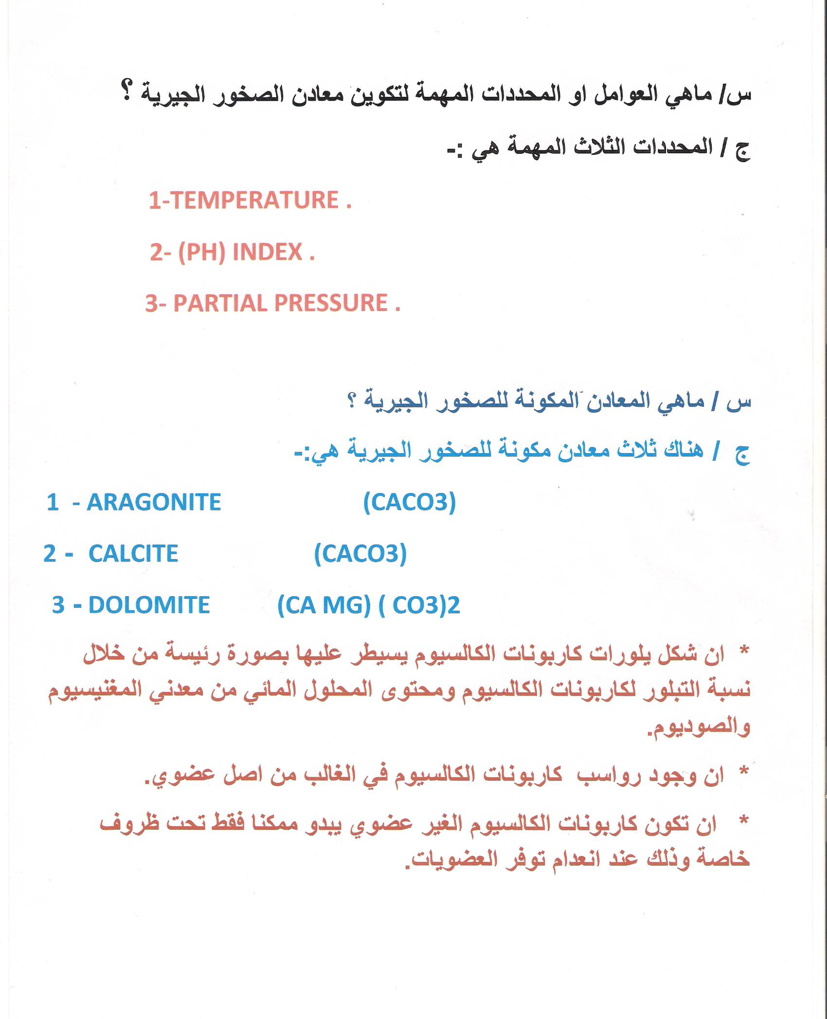

Slide 18
How can carbonate rocks precipitation
Biological
Chemical
Biochemical

Slide 19
نهاية المحاضرة الأولى

Slide 20
Carbonate Sedimentation In Marine Environments

Slide 21
-:Carbonate occur in
1- Eulittoral and supralittoral env. ( principally in tropical and subtropical env.)
2- Sublittoral env. (in water depth approximately between (20-200 m) (shelf and shelf margin)
3- deep sea (down to the calcite compensation depth between 4000- 5000 m (primarily planktonic sedimentation )

Slide 22
Basic Oceanographicall Classification
chart

Slide 24
Setting of carbonate depositional environments

Slide 25
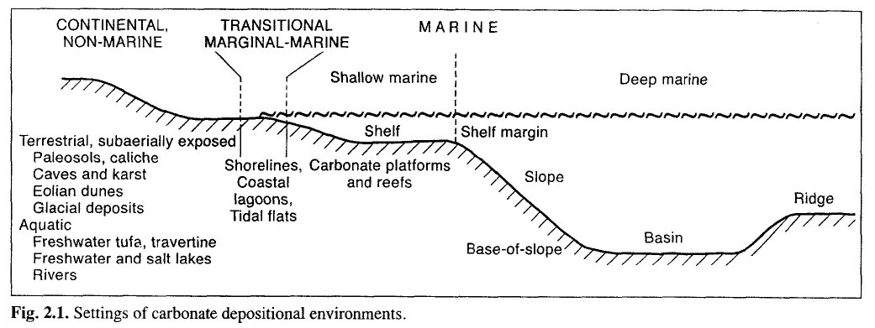

Slide 26
Sublittoral
Eulittoral
Carboate Sedimentation Env.
Deep Sea
Lake & terrestrial

Slide 27
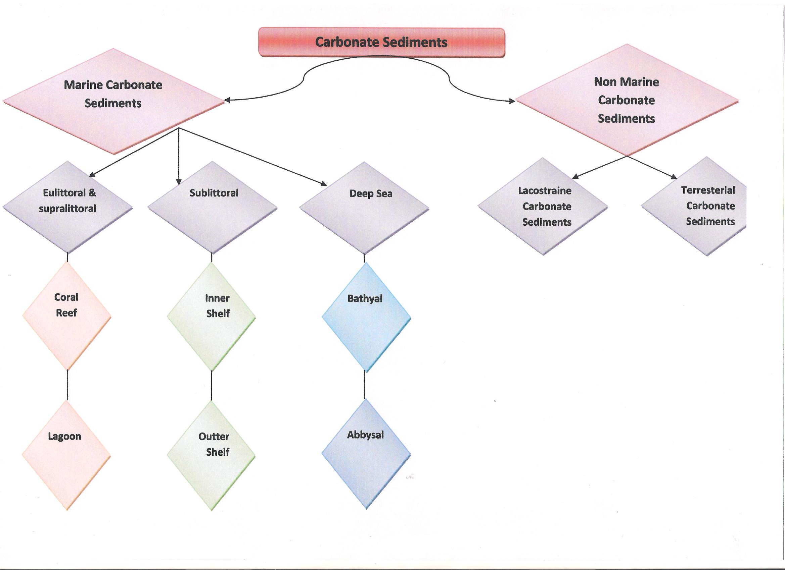

Slide 30
نهاية المحاضرة الثانية

Slide 31
Digenesis Process

Slide 32
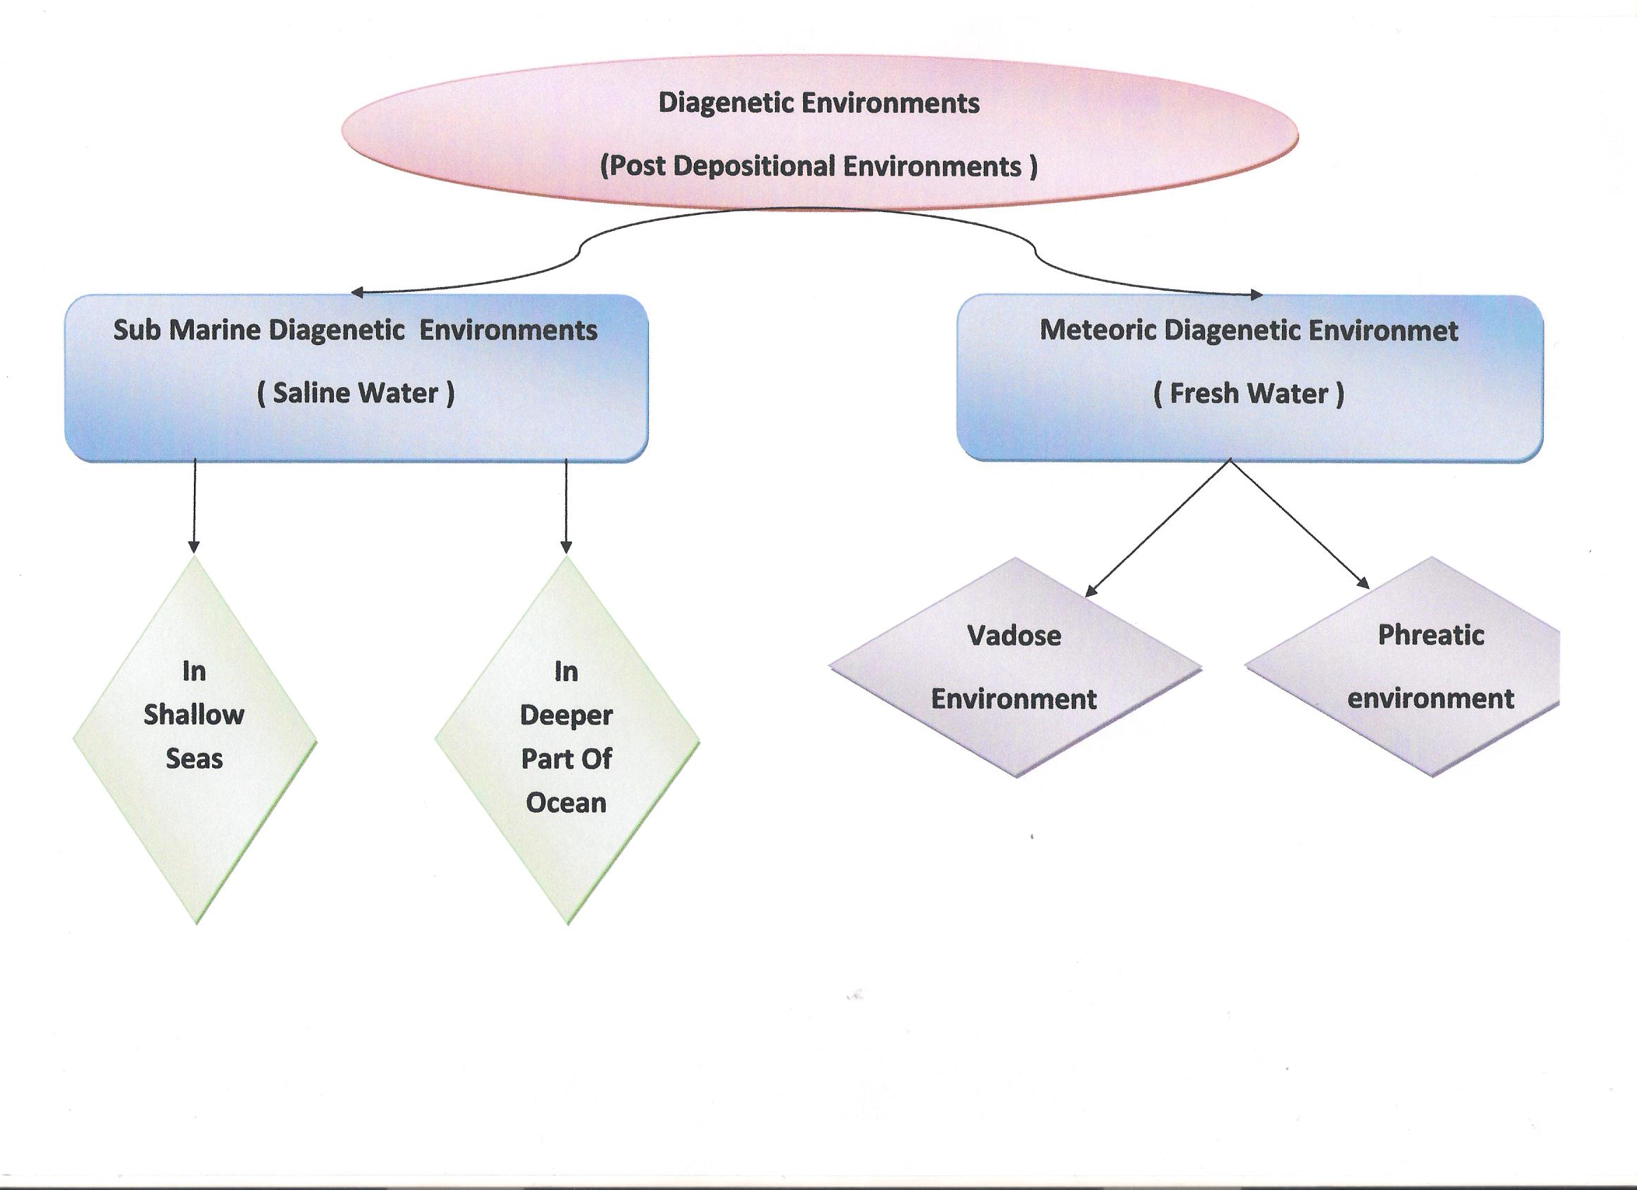

Slide 33
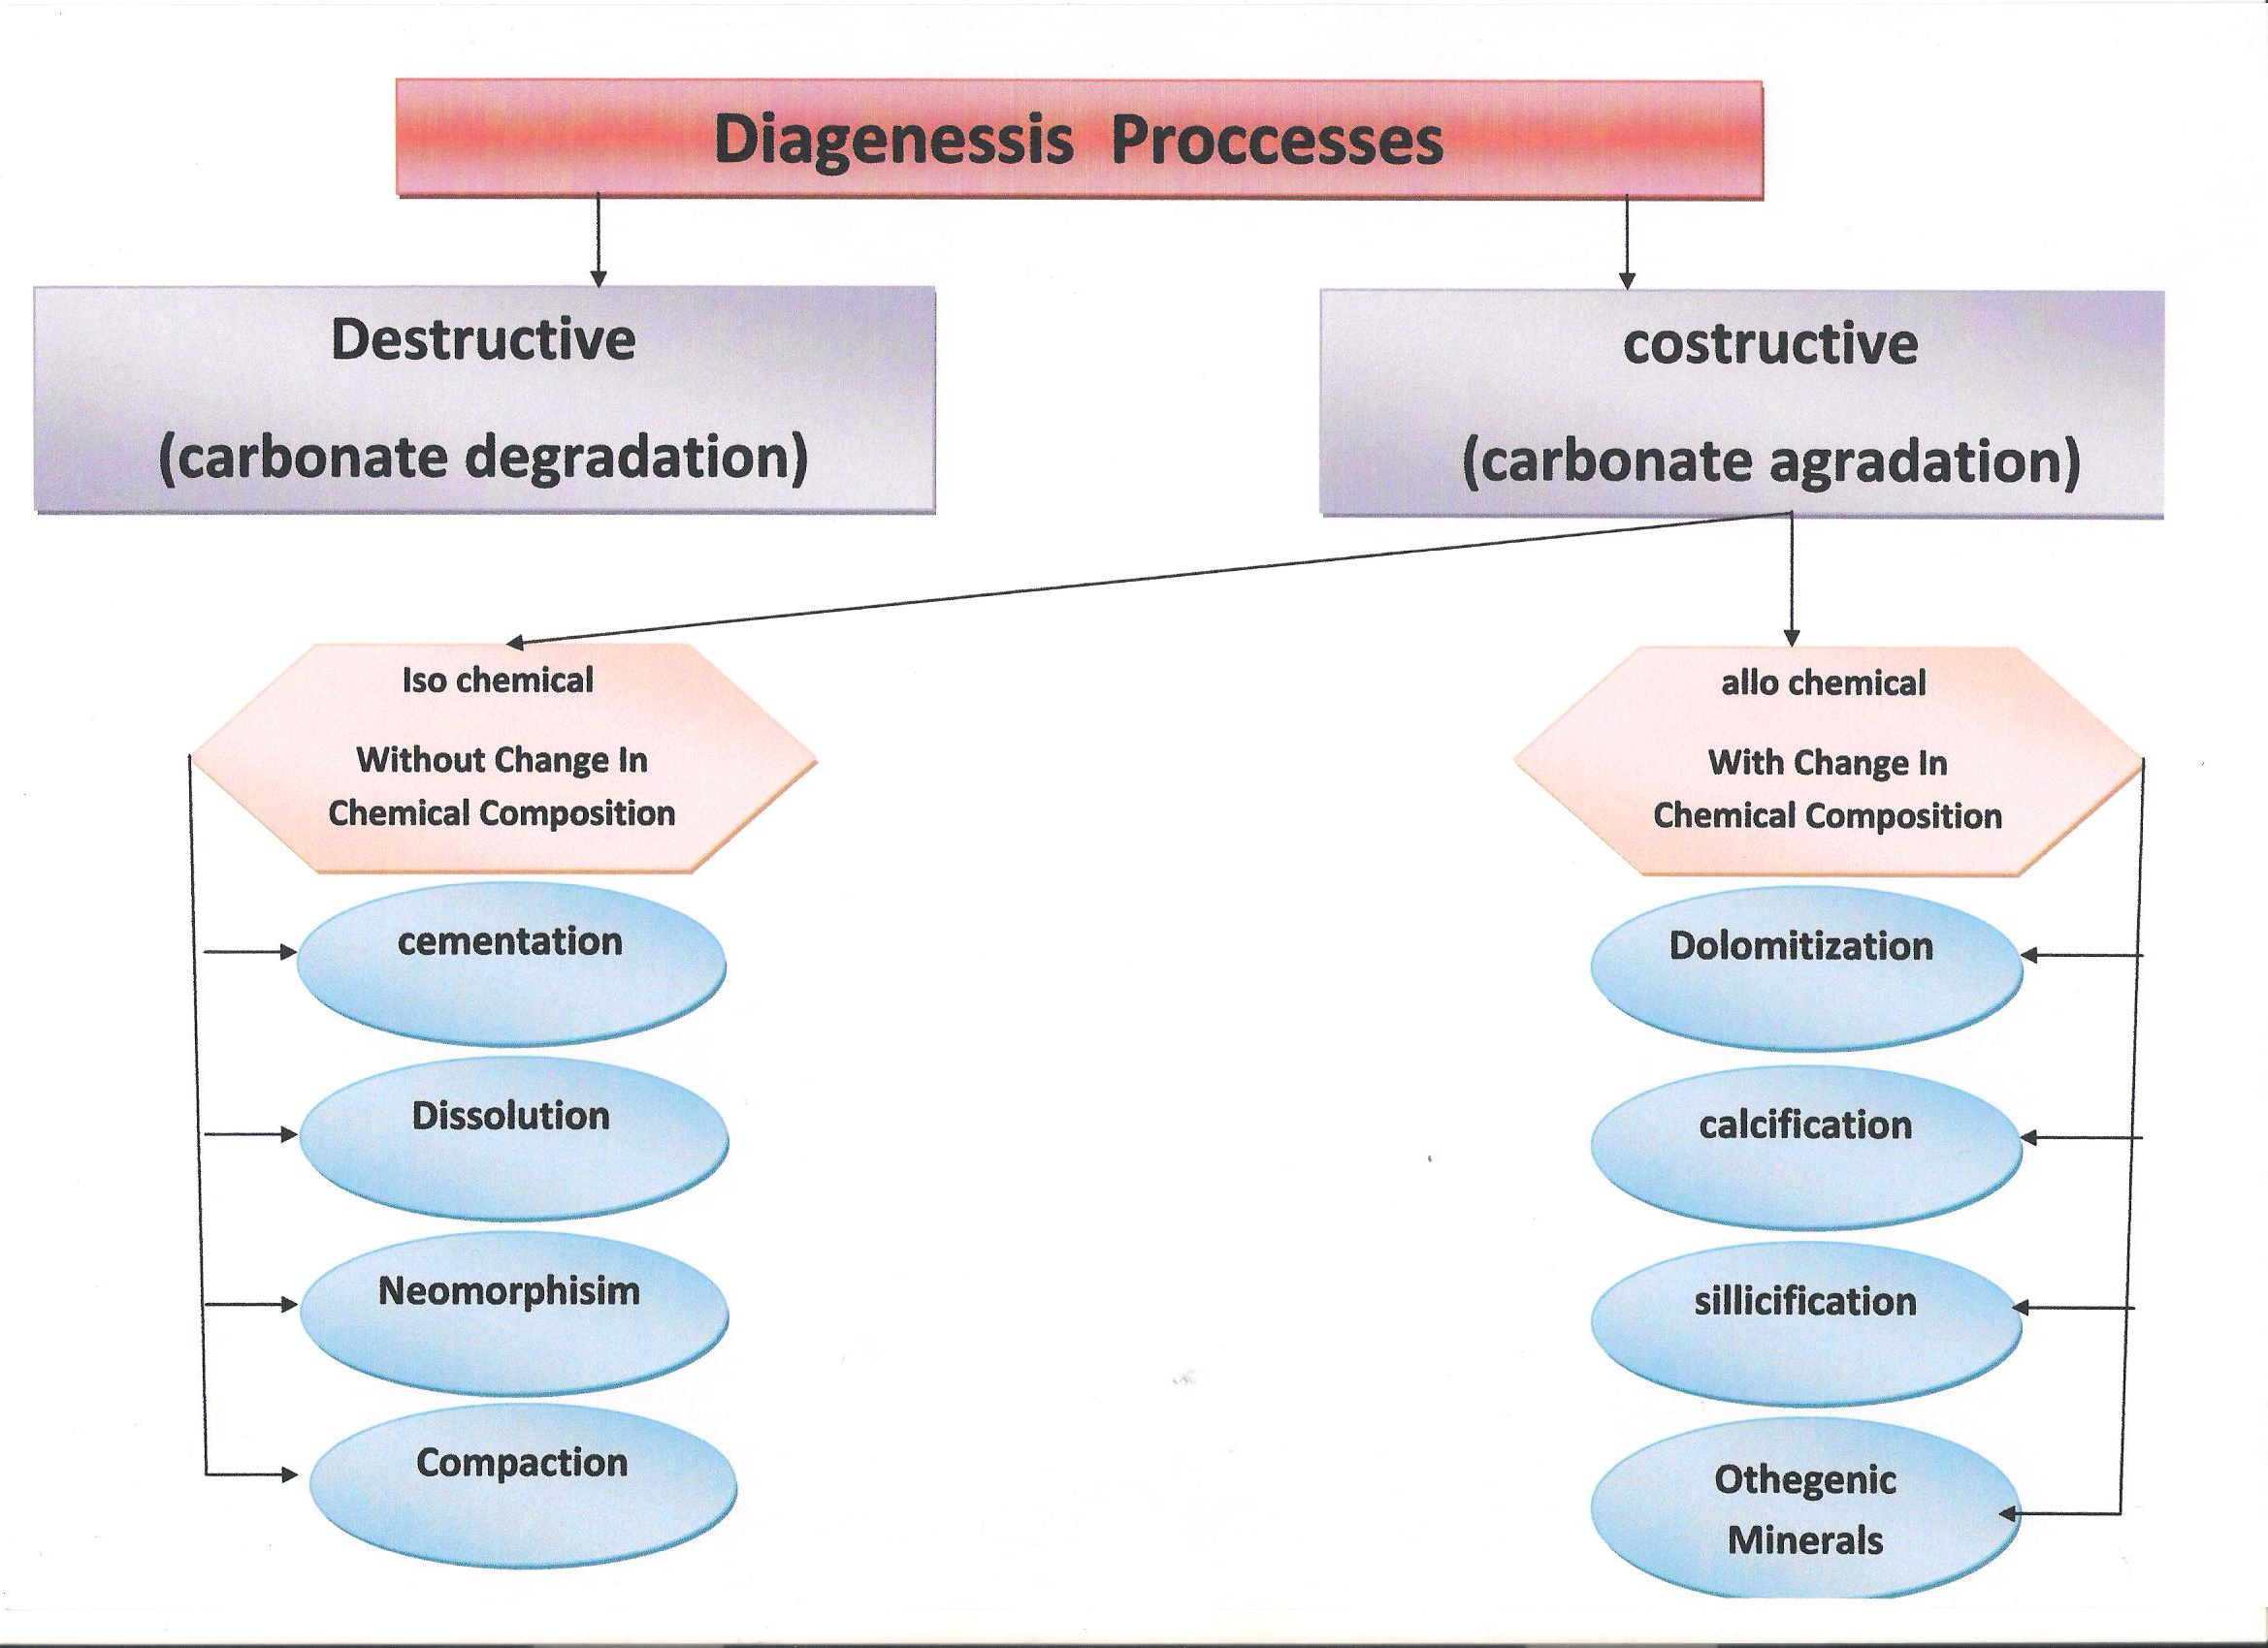

Slide 36
نهاية المحاضرة الثالثة

Slide 37
Microfacies Characterization

Slide 38
Microfacies characteristics as seen in Thin section include of four criteria
The type of groundmaas
The different kind of partical
Depositional texture
Solution texture

Slide 39
There are three elements of microfacies character :-
1- Groundmass
2- Particles
3- Pores

Slide 40
Petro graphical components of Microfacies
Groundmass
Partical
Pore
FABRIC SELECTIVE
NOT FABRIC SELECTIVE
Skeletal
Non skeletal
Micrite
Sparite
MICROFOSSILS
1- OOLITE
2- PELLETS
3-PELOIDS
4- ONKOID
5- AGREGATED
GRAINS

Slide 41
Microfossils Shape In Microfacies
Needle
Segmoidal
Pranch
Chamber
Massive
Incarsted

Slide 42
Pore types in microfacies

Slide 43
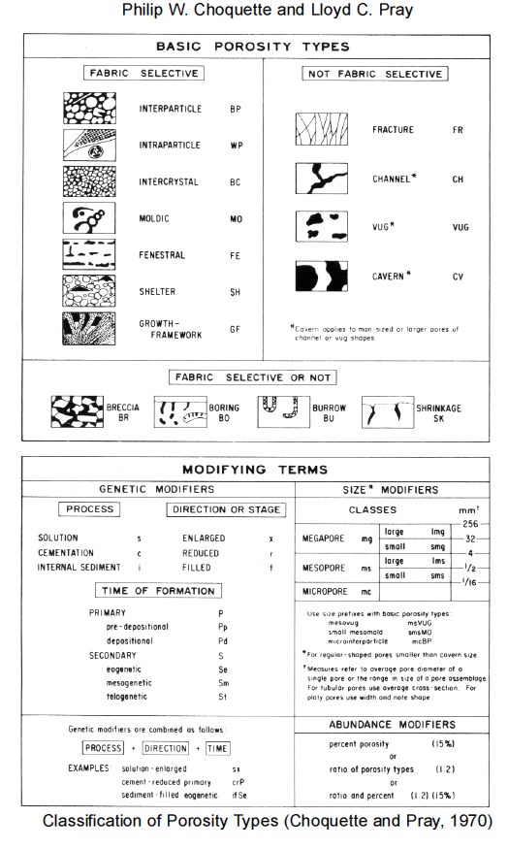

Slide 44
نهاية المحاضرة الرابعة

Slide 45
Classification Of Microfacies

Slide 46
Folk Classification

Slide 47
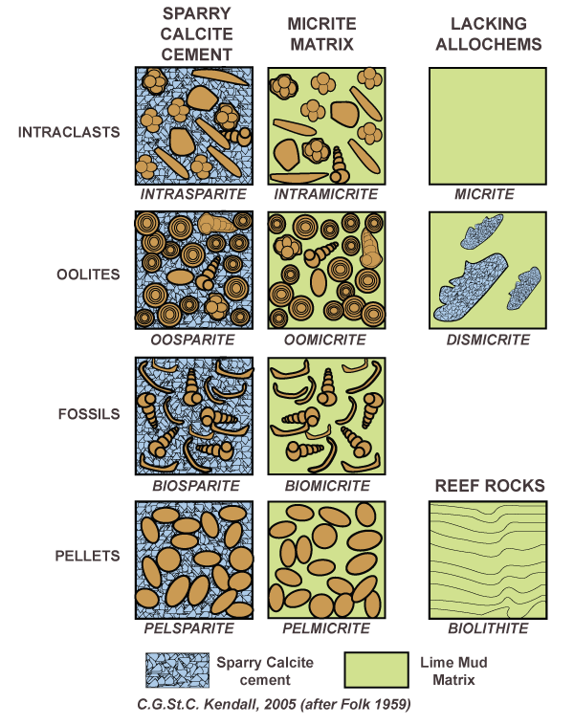

Slide 48
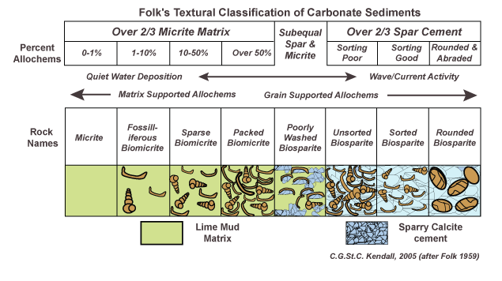

Slide 49
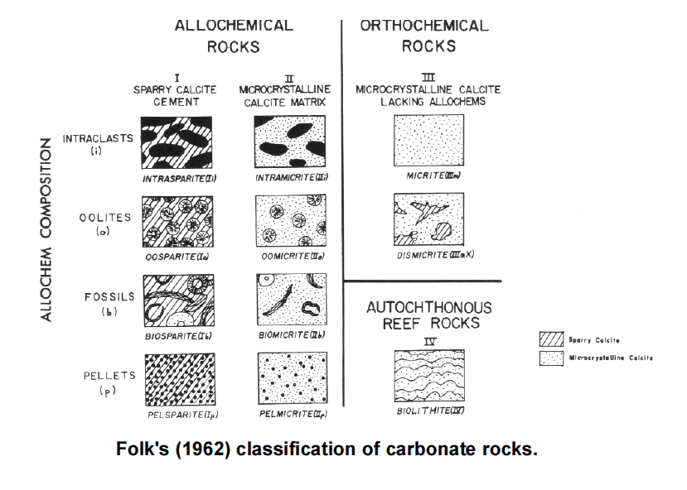

Slide 50
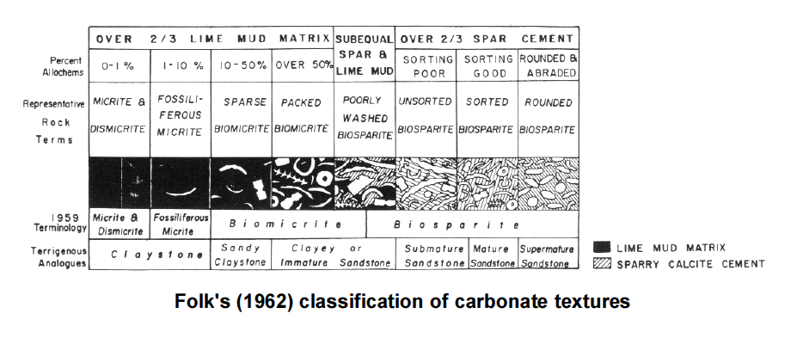

Slide 51
Dunham Classification

Slide 52
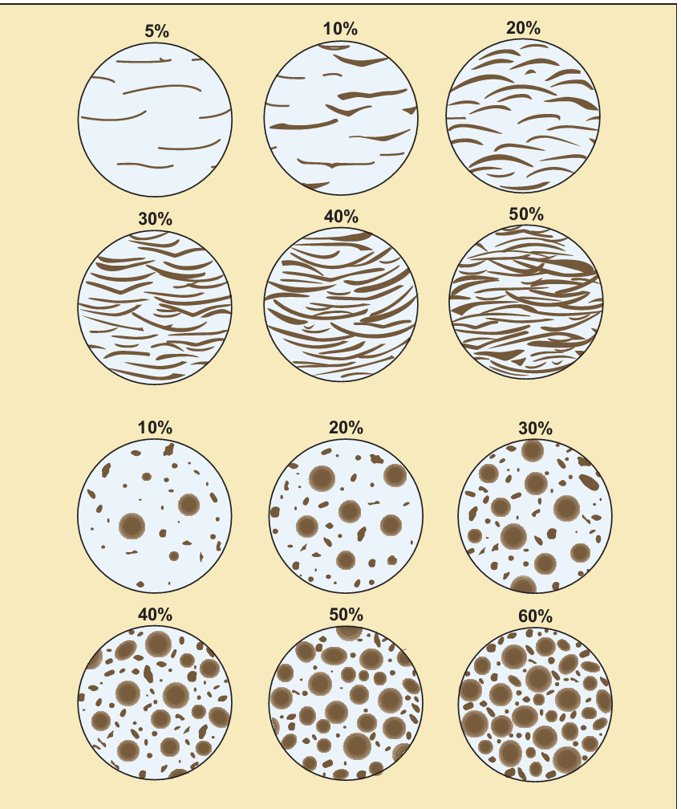

Slide 53
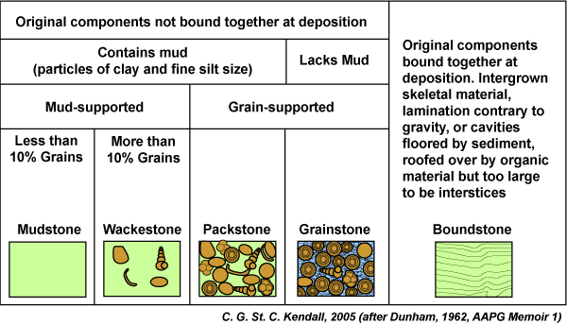

Slide 54
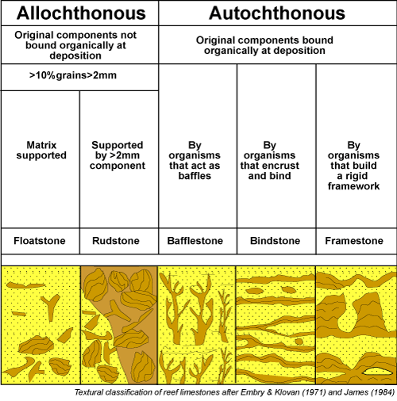

Slide 55
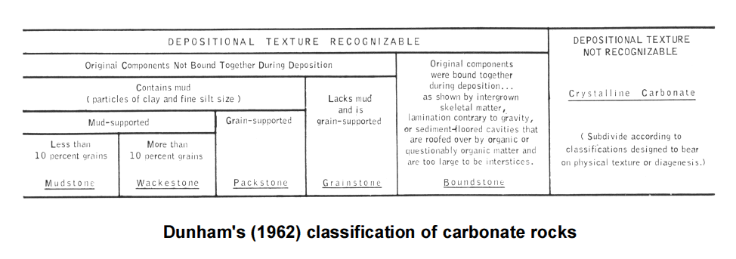

Slide 56
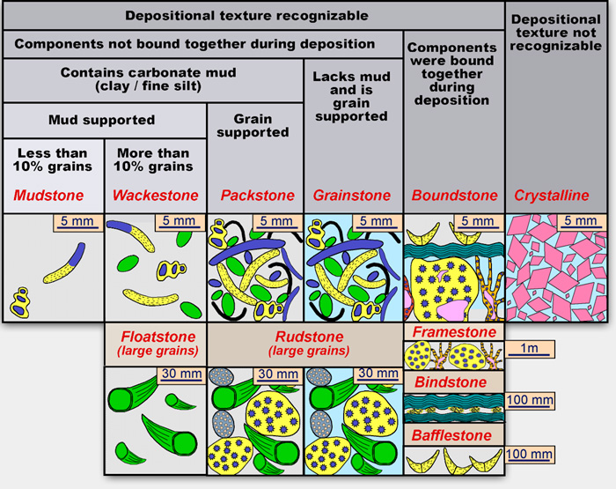

Slide 57
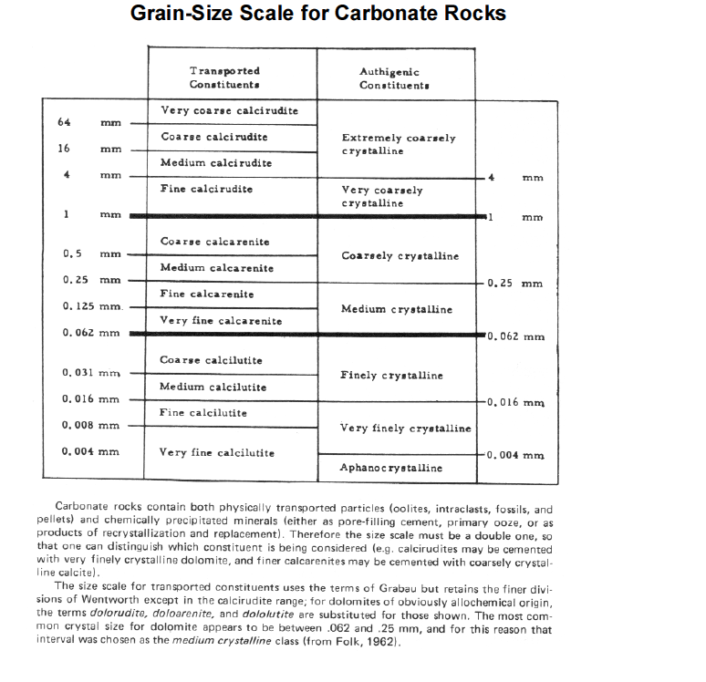

Slide 58
نهاية المحاضرة الخامسة

Slide 59
Standard Microfacies

Slide 60
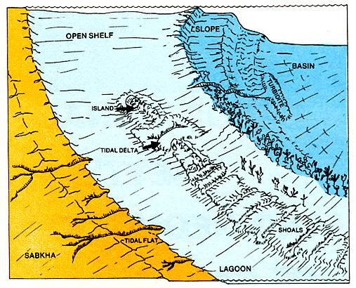
Varied settings of carbonate deposits

Slide 61
Wilson’s Chart

Slide 62
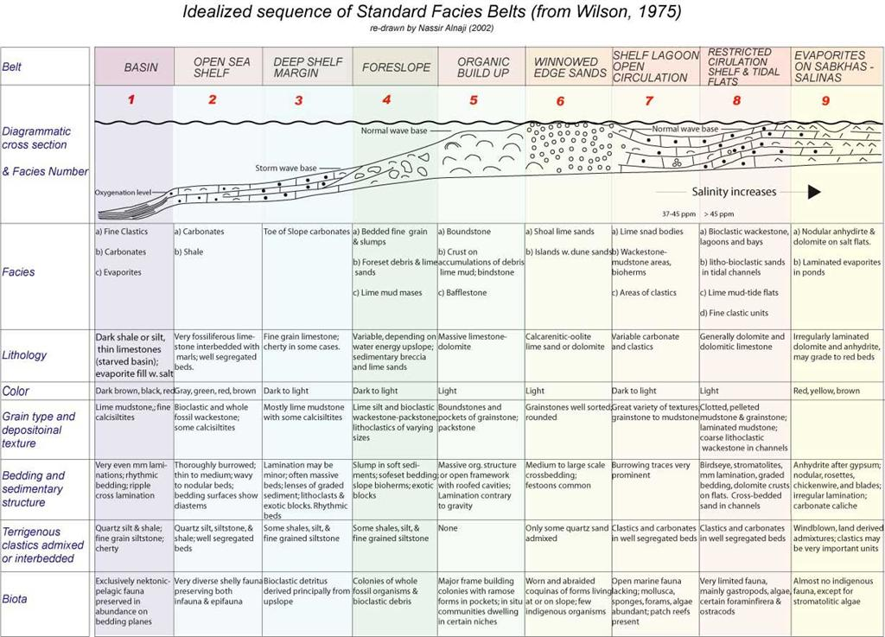

Slide 63
Facies Model

Slide 64
Evolution of Carbonate Sequences

Slide 65
Summary Variations in carbonate depositional settings through time produce corresponding changes in their lateral and vertical facies geometry. High frequency changes in facies are induced by sea level, and climate, whereas long-term low frequency changes are commonly related to paleo-geography and plate configurations or the evolutionary changes in the carbonate producing organisms. The sections below provide a general and classical introduction to the eclectic responses of carbonates to changes in their setting. Click here to link to a more detailed examination of the details of the sequence stratigraphy of carbonates.

Slide 66
Controls On Carbonate Deposition

Slide 67
The geometry and facies relationships of carbonate accumulations are closely tied to the paleogeographic setting and changes in that setting through time, particularly water depth variation. Paleolatitude and clastic influx are major influences on the distribution of the carbonates, with facies largely controlled by the proximity of the depositional basin to open marine circulation and the position of the depositional setting within the basin. carbonate sediments and their associated buildups are largely the by products of organisms whose evolution has a significant influence on carbonate deposition. Wilson (1975) reviews in detail some of the similarities and differences that occur in carbonates of different ages.

Slide 68
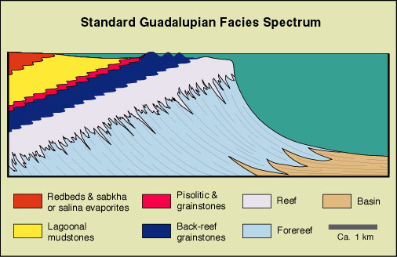

Slide 69
Platform Types
1- Ramp
2- Epiric Shelf
3- Shelf

Slide 70
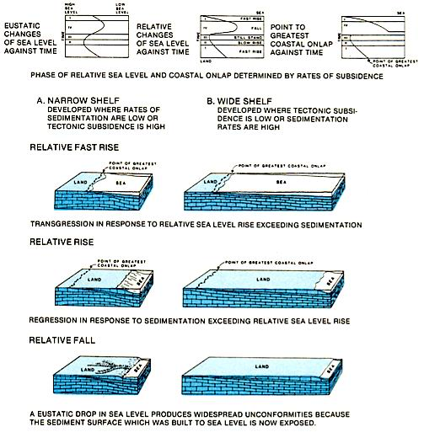

Slide 71
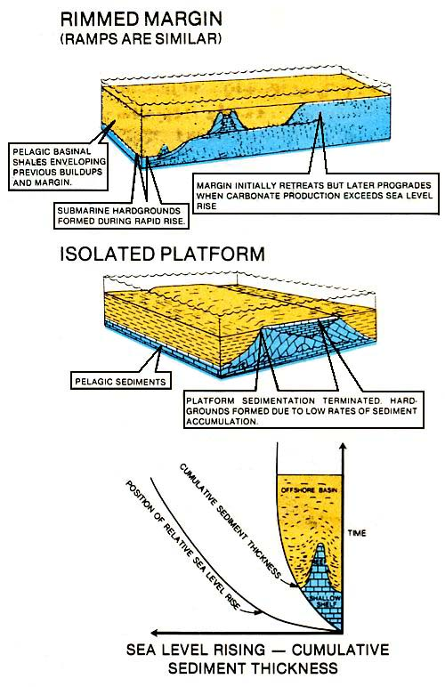

Slide 72
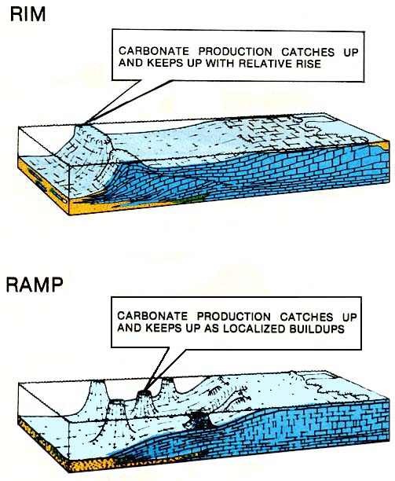

Slide 73
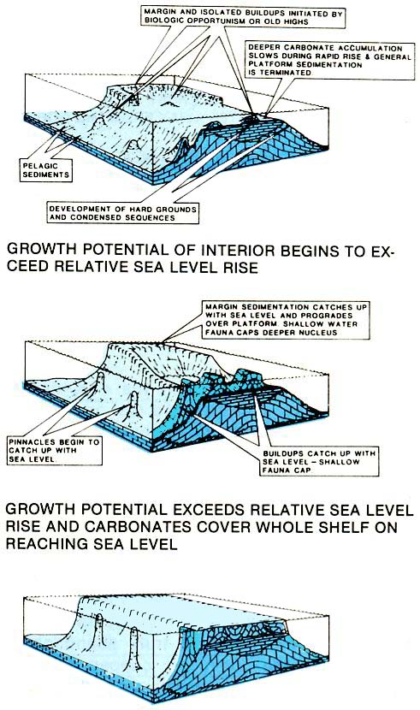

Slide 74
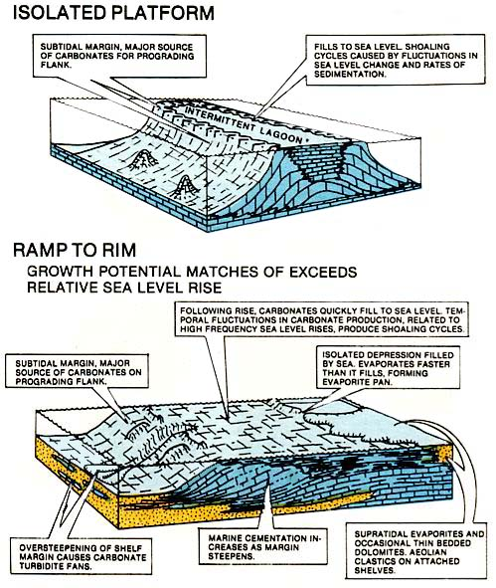

Slide 75
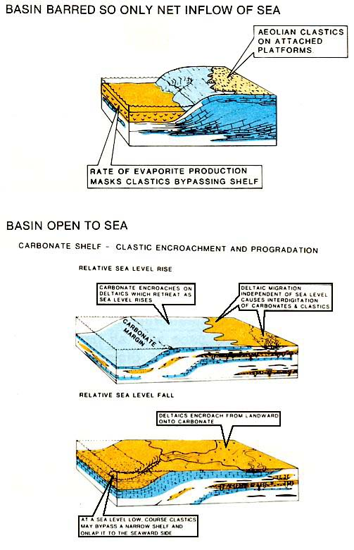

Slide 76
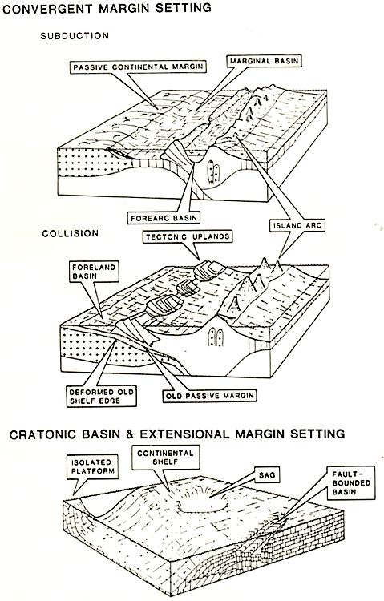
Location of carbonate basins on plate margins

Slide 77
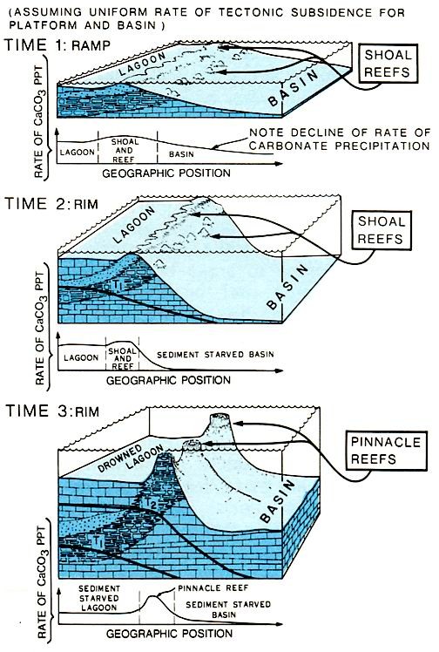

Slide 78
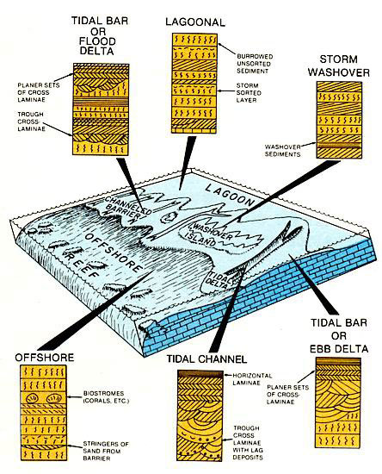

Slide 79
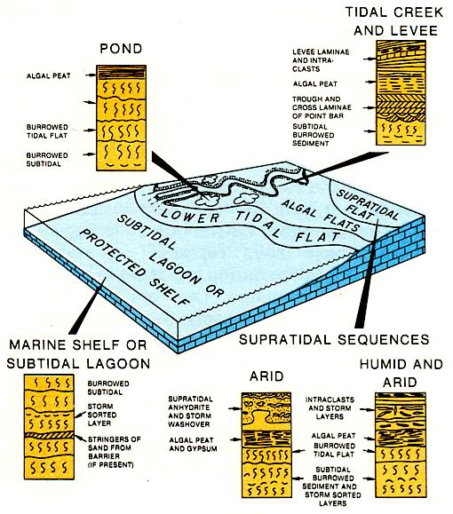

Slide 80
